Slide 1

UNIT 1: Who am I?
Tia’s family

Slide 2

Present the family tree of your new identity.

Slide 3
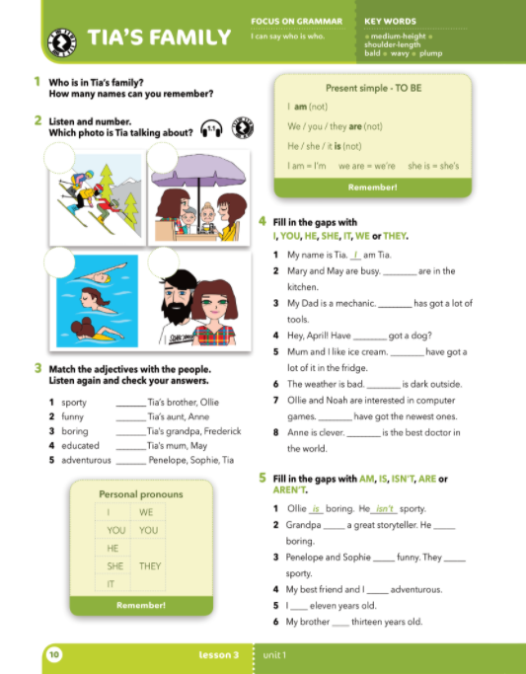
Who is in Tia’s family?
How many names can you remember?

Slide 4
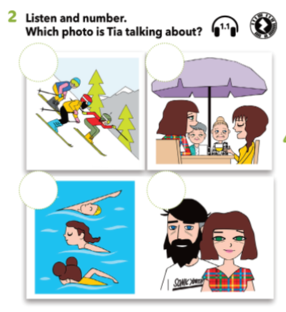

Describe the pictures. Do you know the names of the characters in the picture?
2
3
Listen and number the pictures.
4
1
https://www.e-sfera.hr/dodatni-digitalni-sadrzaji/0cf8032a-c871-4fcd-bb0c-6c9915185ff1/

Slide 5
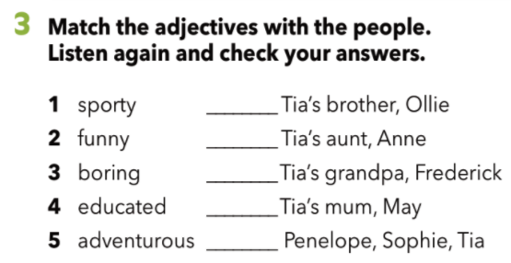
https://www.e-sfera.hr/dodatni-digitalni-sadrzaji/0cf8032a-c871-4fcd-bb0c-6c9915185ff1/
Match the adjectives with the people.
Listen again and check your answers.
3
4
5
2
1
What is the meaning of these words?
educated -
adventurous -
obrazovan
pustolovan

Slide 6
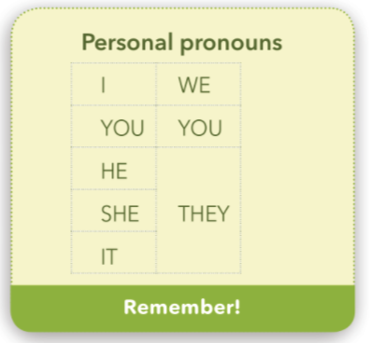
ja
mi
I - we -
you - you -
he - they -
she -
it -
ti
vi
on
oni, one, ona
ona
ono

Slide 7
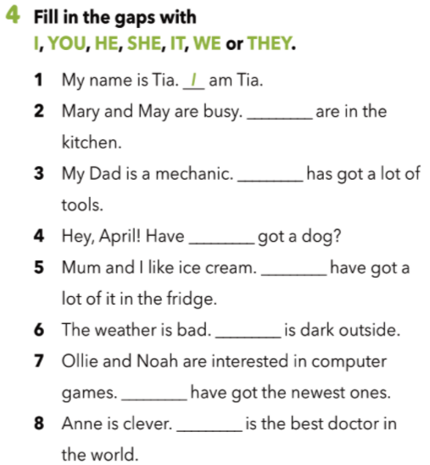
Fill in the gaps with the words given.
They
He
Check your knowledge:
https://wordwall.net/embed/b517c72a82354d1e8a9e7db734469172?themeId=46&templateId=5
you
We
It
They
She

Slide 8

am
is
are
Ja sam -
I am
he
you
Ti si -
You are
I
she
we
On je -
He is
it
they
Ona je -
She is
Ono je -
It is
Mi smo -
We are
Vi ste -
You are
Oni (one, ona) su -
They are

Slide 9
am not
is not
(isn’t)
are not
(aren’t)
Ja nisam -
I am not
Ti nisi -
You are not
I
he
you
On nije -
He is not
she
we
Ona nije -
She is not
it
they
Ono nije -
It is not
Mi nismo -
We are not
Vi niste -
You are not
Oni (one, ona) nisu -
They are not

Slide 10
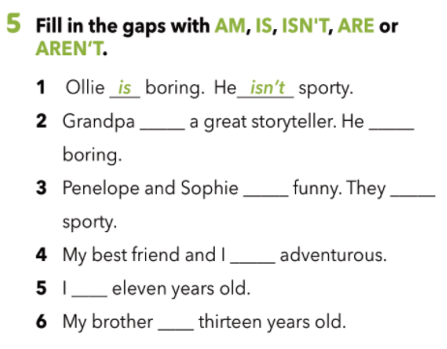
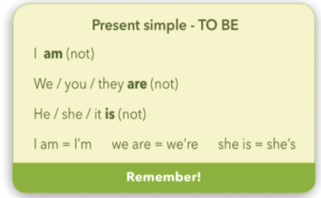
Fill in the gaps with the words given.
is
isn’t
aren’t
are
are / aren’t
am /
am not
is / isn’t

Slide 11
Let’s practise!
Workbook, page 9 and 10.
Npr. May is funny. He / She is funny.
Npr. This is my best friend, Nicola.
This is my best friend, Nicola. → This isn’t my best friend, Nicola
Play the game:
https://play.kahoot.it/v2/?quizId=87aec4f2-8cda-4cf2-9e7f-33636911b18b

Slide 12
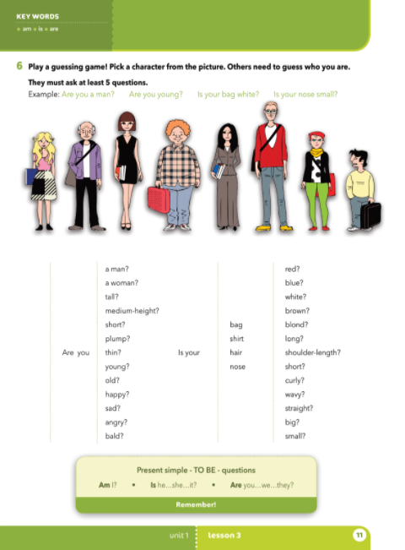
Look at the pictures. Pick a character from the picture and describe him or her.
Example: This man is tall and thin…

Slide 13
tall - bald -
medium-height - blond -
short - shoulder-length -
plump - curly -
thin - wavy -
young - straight -
old -
visok
ćelav
srednje visine
plave kose
nizak
do ramena
punašan
kovrčav
mršav
valovit
mlad
ravan
star
Let’s practise
https://wordwall.net/play/4444/156/669?fbclid=IwAR1WkT2FSWMoNX-PLO3sny3st6ea5Q3DZ7GtqWVWoIVKJjTpt5FR5roC6BU

Slide 14
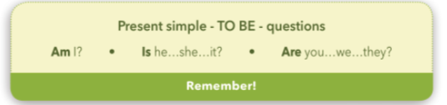
YES/NO questions
Look at the examples:
I am short. → Am I short?
He is old. → Is he old?
They are funny. → Are they funny?
Kad postavljamo pitanje mijenjamo položaj riječi u rečenici!

Slide 15
Let’s practice!
https://www.bookwidgets.com/play/4BFBS4W?teacher_id=6569556414824448
https://learningapps.org/watch?v=pdesznmx320
https://www.e-sfera.hr/dodatni-digitalni-sadrzaji/0cf8032a-c871-4fcd-bb0c-6c9915185ff1/

Slide 16
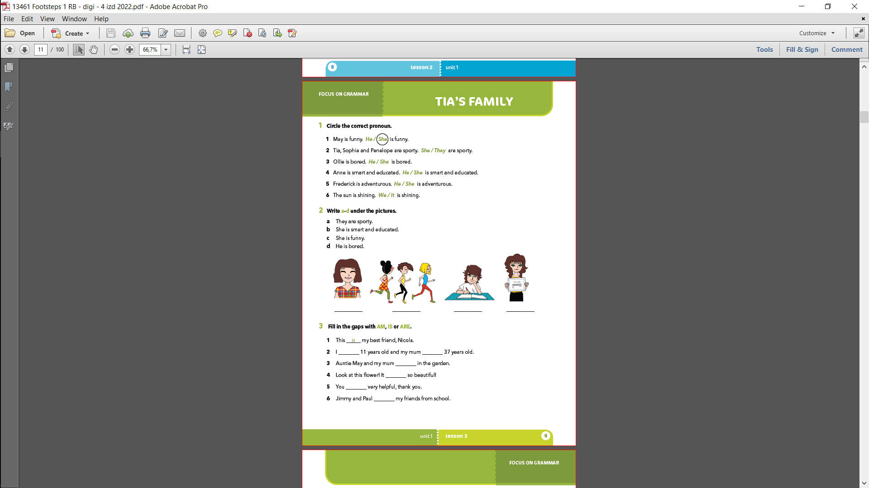

Slide 17
c
a
d
b

Slide 18
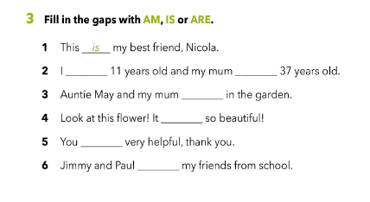
am
is
are
is
are
are

Slide 19
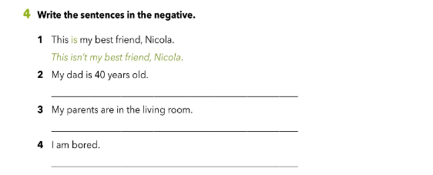
My dad isn’t 40 years old.
My parents aren’t in the living room.
I am not bored.

Slide 20
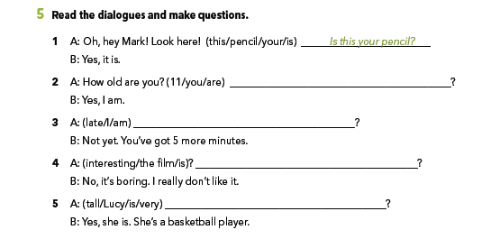
Are you 11?
Am I late?
Is the film interesting?
Is Lucy very tall?

